Slide 1
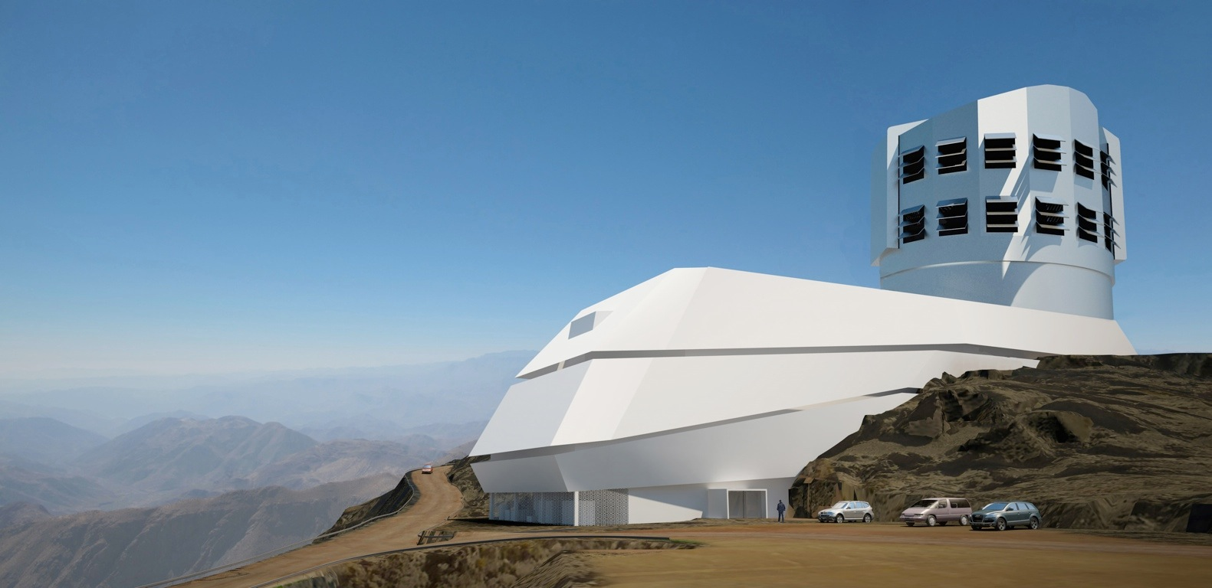

Lecture 19: Big Data Challenges from LSST
Željko Ivezić, University of Washington
Sao Paulo Course, Aug 23, 2021

Slide 2
Outline
Rubin Observatory and LSST - multi-color time-resolved faint sky map - 20 billion stars and 20 billion galaxies
Data analysis challenges ahead of us - large data sets - complex analysis - aiming for small systematics

Slide 3
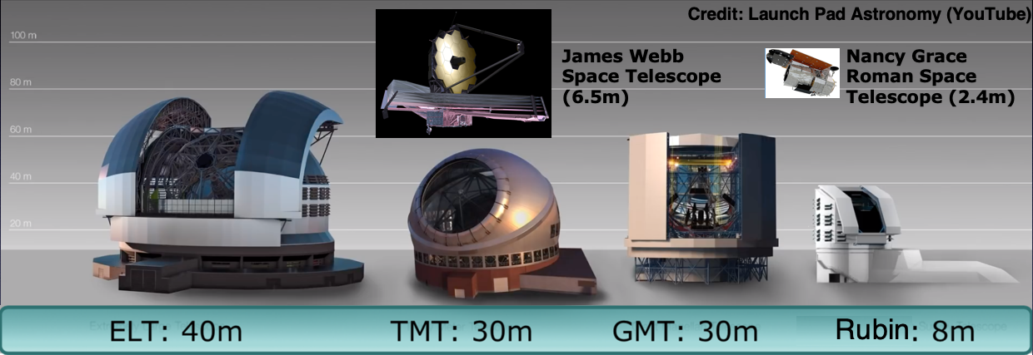

Slide 4
Rubin Obs. will not have the largest mirror but will have by far the largest product of the mirror area and the field-of-view size (etendue or throughput)

Slide 5

Rubin Obs. will not have the largest mirror but will have by far the largest product of the mirror area and the field-of-view size (etendue or throughput)
LSST will be delivered by the
Vera C. Rubin Observatory,
as its first, 10-year, project

Slide 6
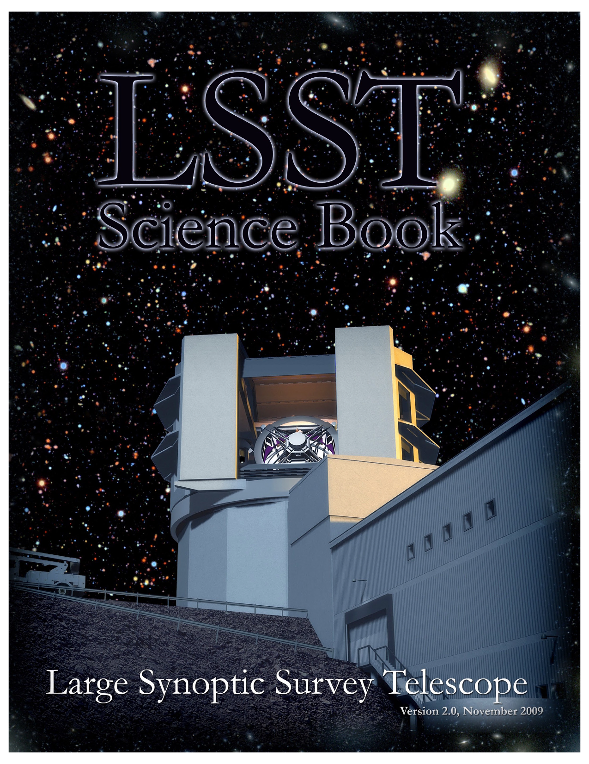
Science Themes for
Legacy Survey of Space and Time
Dark matter, dark energy, cosmology (spatial distribution of galaxies, gravitational lensing, supernovae, quasars)
Time domain (cosmic explosions, variable stars)
The Solar System structure (asteroids)
The Milky Way structure (stars)
LSST Science Book: arXiv:0912.0201
Summarizes LSST hardware, software, and observing plans, science enabled by LSST, and educational and outreach opportunities
245 authors, 15 chapters, 600 pages

Slide 7
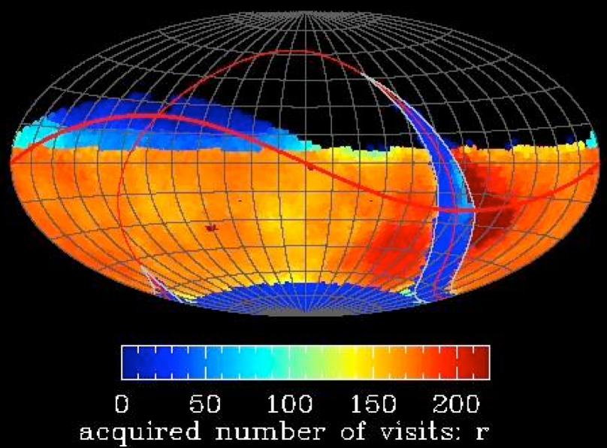
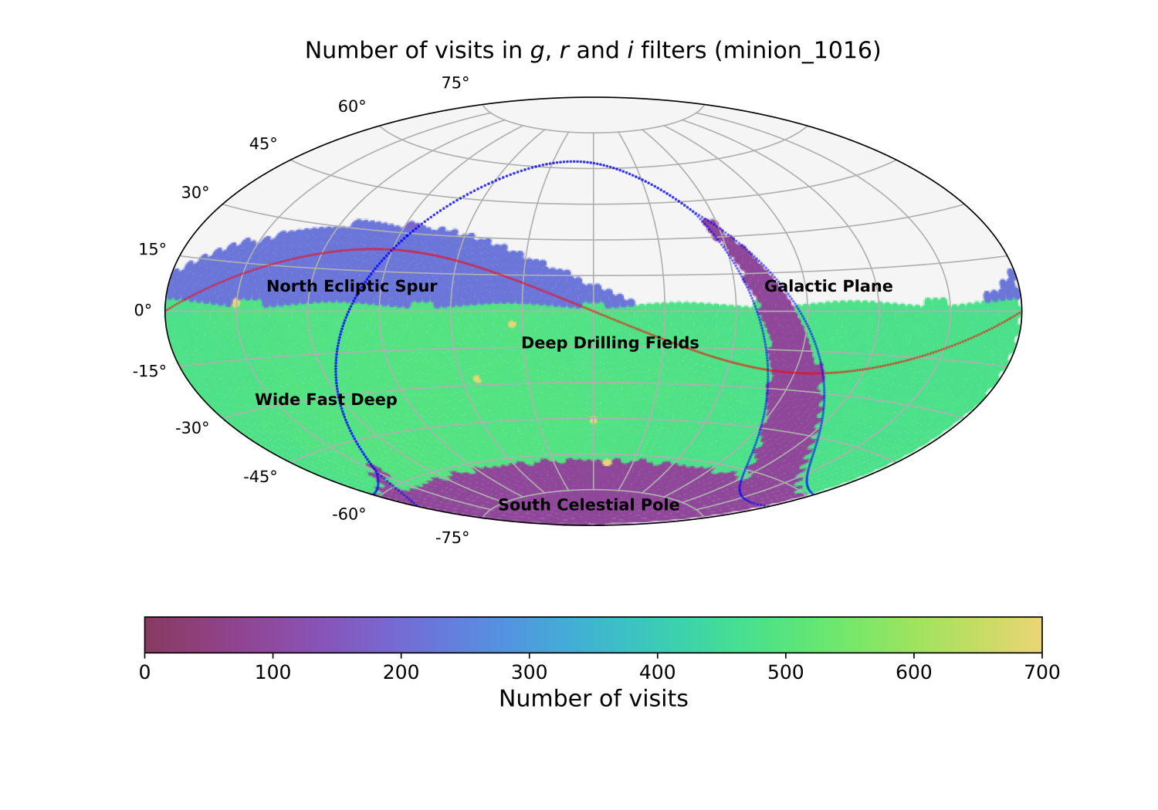
Basic idea behind LSST: a uniform sky survey
90% of time will be spent on a uniform survey: every 3-4 nights, the whole observable sky will be scanned twice per night
after 10 years, half of the sky will be imaged about 1000 times (in 6 bandpasses, ugrizy): a digital color movie of the sky
~100 PB of data: about a billion 16 Mpix images, enabling measurements for 40 billion objects
LSST in one sentence:
An optical/near-IR survey of half the sky in ugrizy bands to r~27.5 (36 nJy) based on 825 visits over a 10-year period: deep wide fast.
Left: a 10-year simulation of LSST survey: the number of visits in the r band (Aitoff projection of eq. coordinates)

Slide 8
SDSS
gri
3.5’x3.5’
r~22.5
3 arcmin is 1/10 of the full Moon’s diameter

Slide 9
HSC
gri
3.5’x3.5’
r~27
3 arcmin is 1/10 of the full Moon’s diameter
like LSST depth (but tiny area)
LSST will deliver 5 million such images

Slide 10
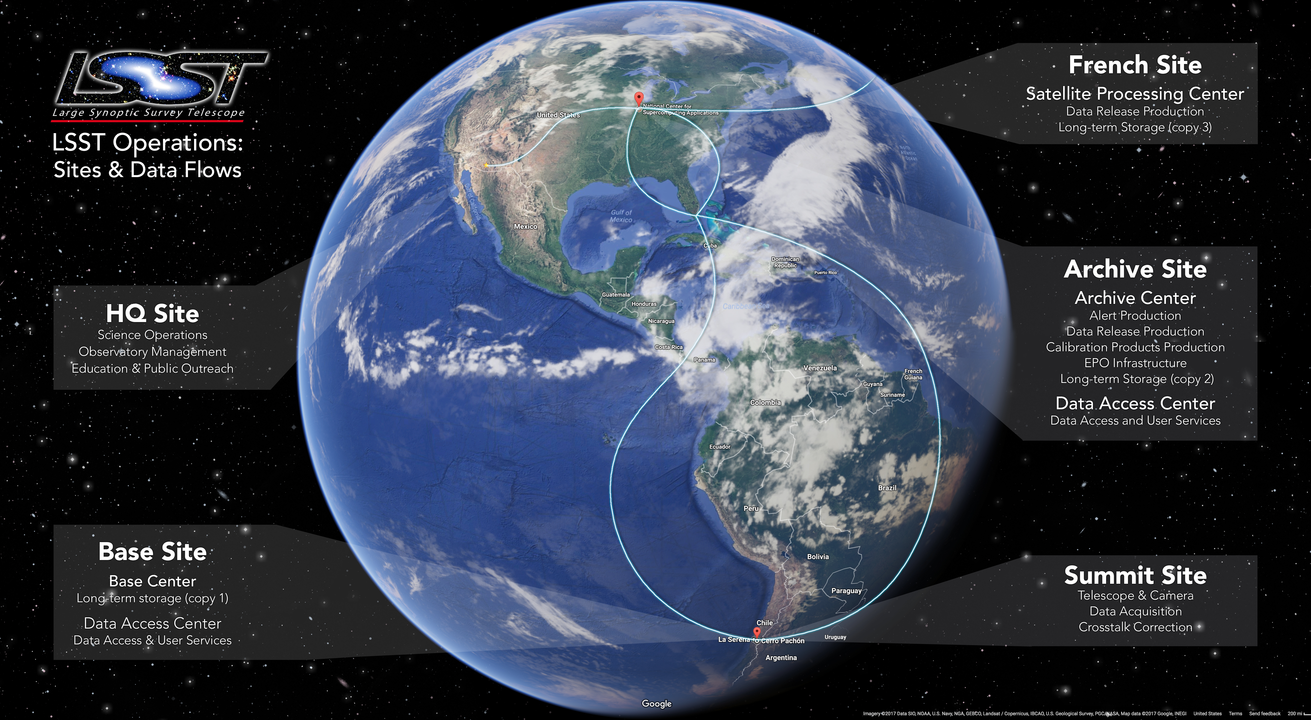

Slide 11
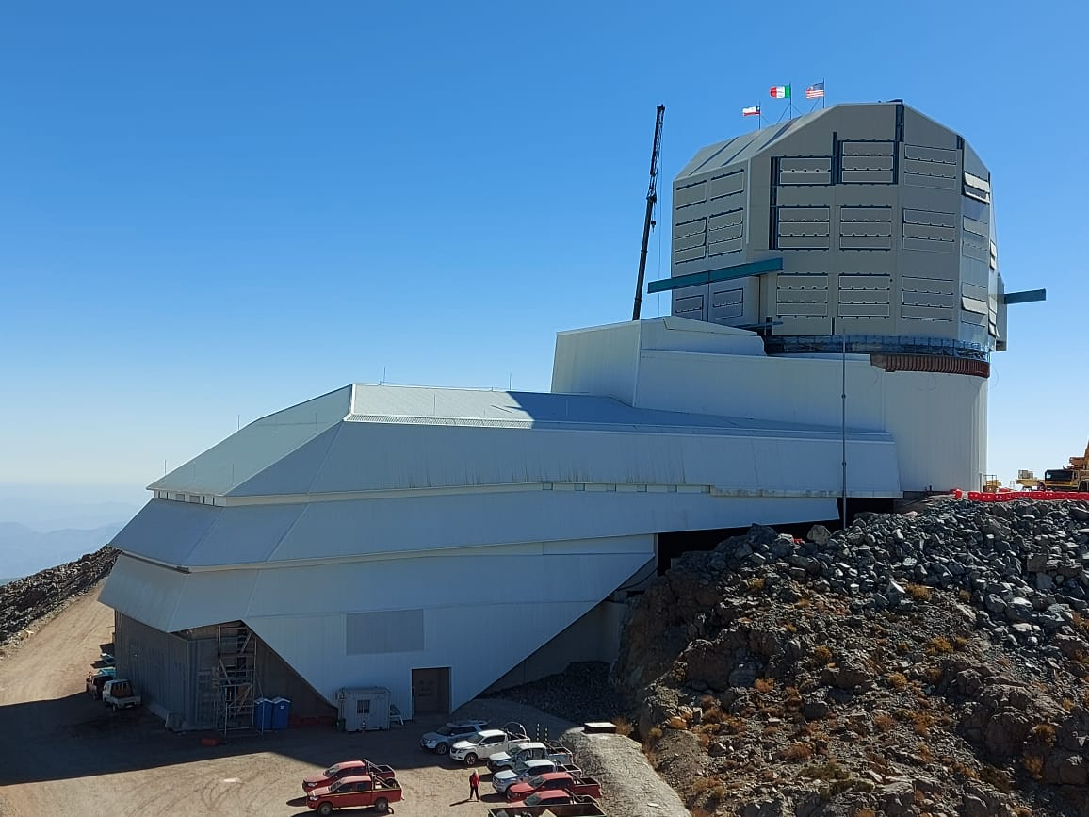

Slide 12
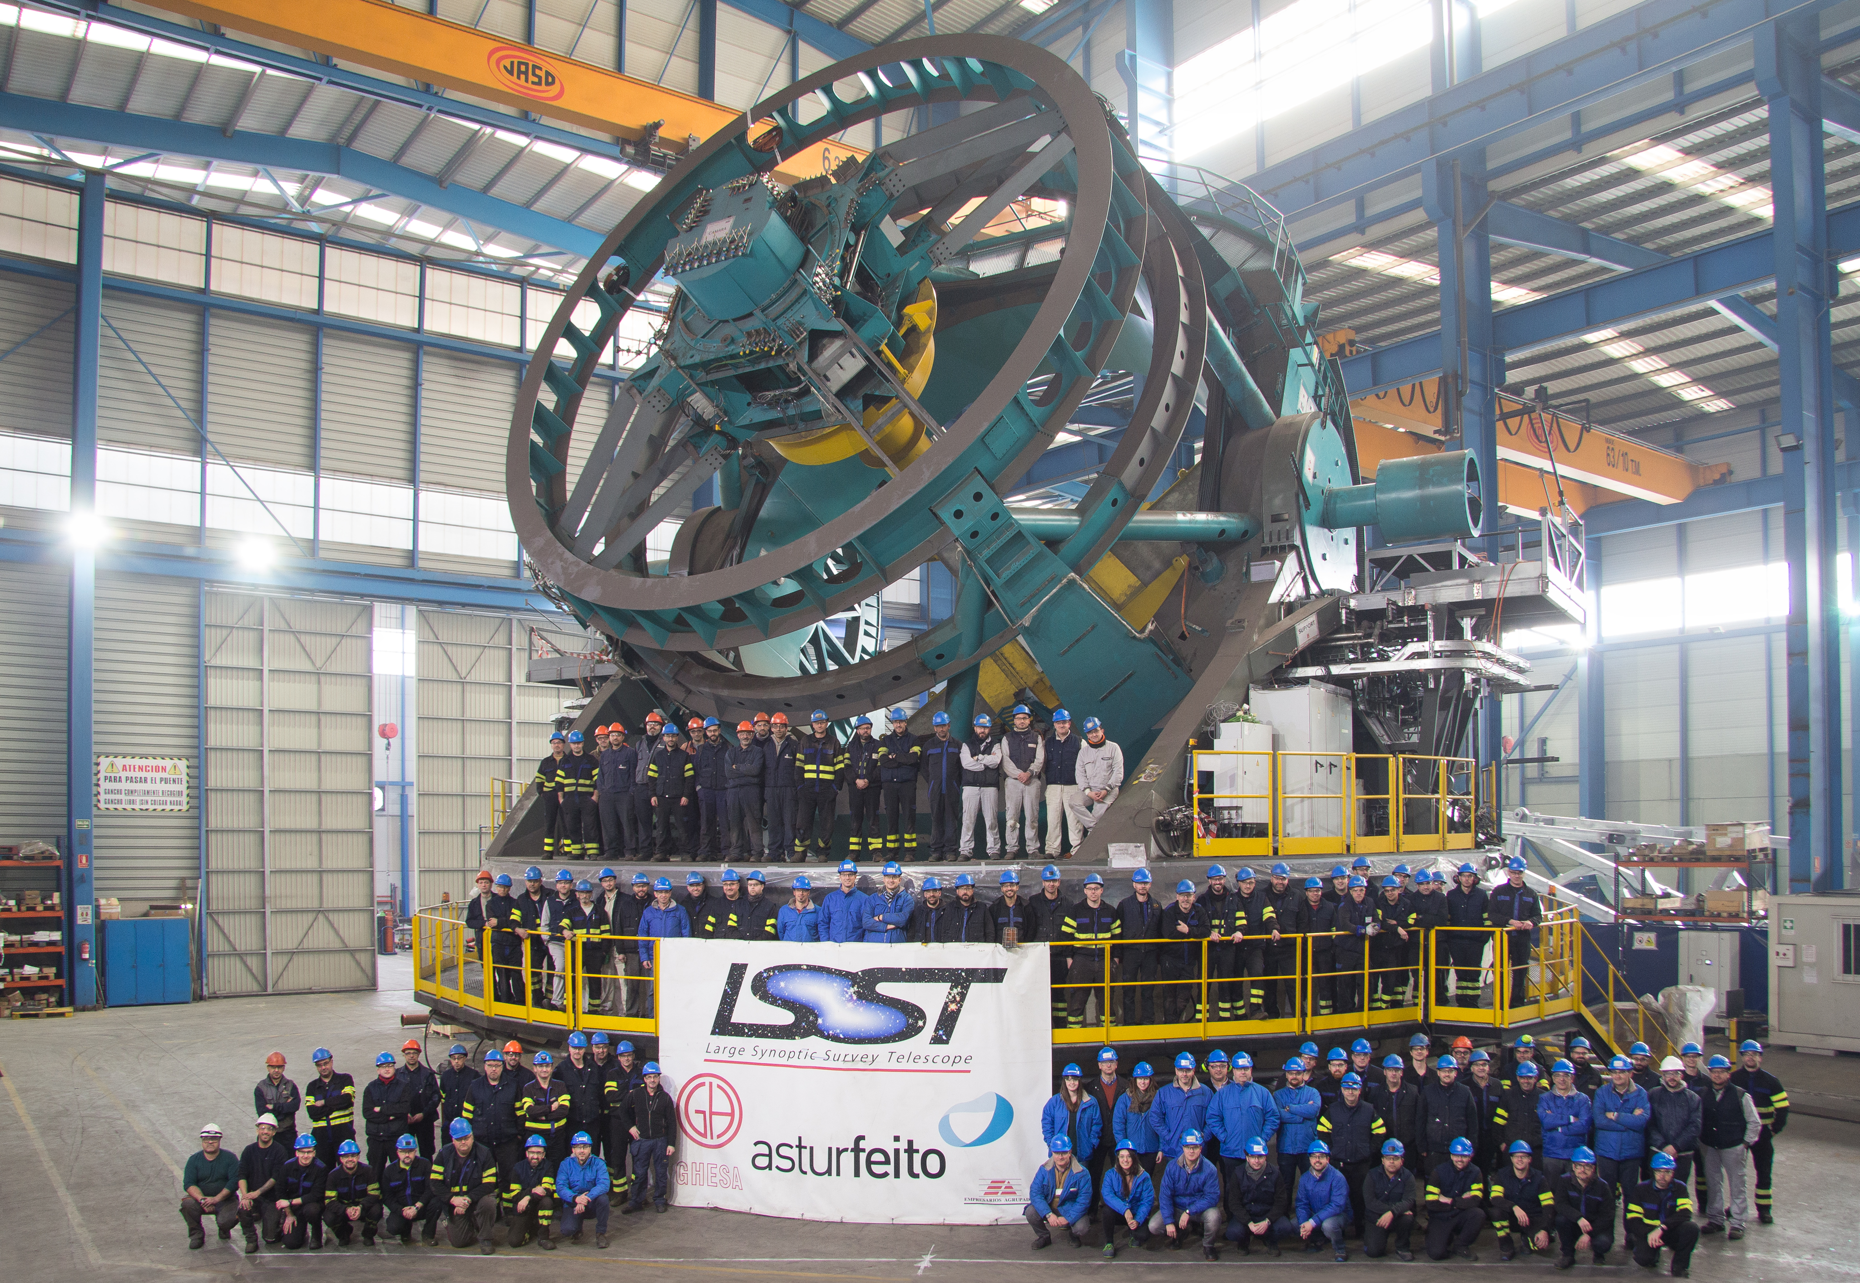
8.4m, 6.7m effective
5 sec slew & settle
Telescope Mount Assembly before going from Spain to Chile

Slide 13
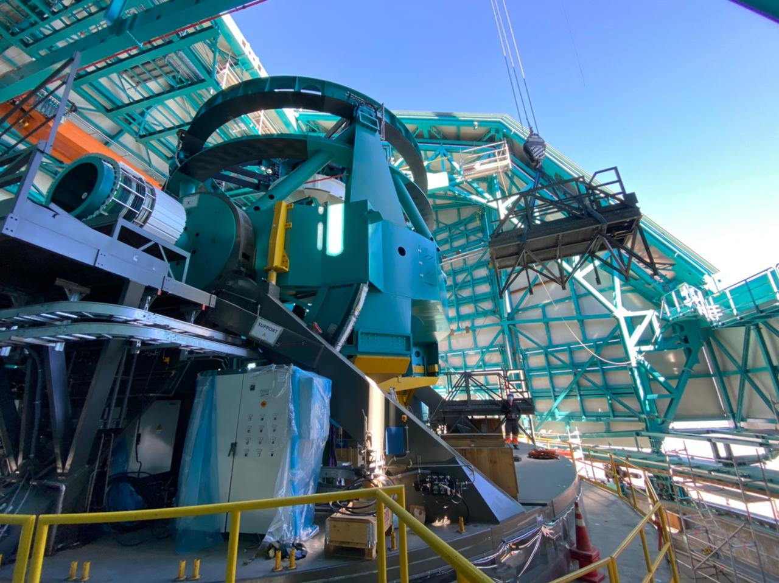

Slide 14
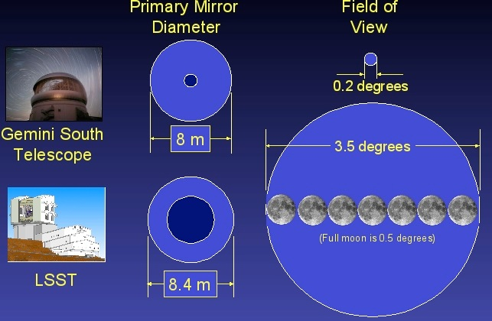
The field-of-view comparison: Gemini vs. LSST

Slide 15
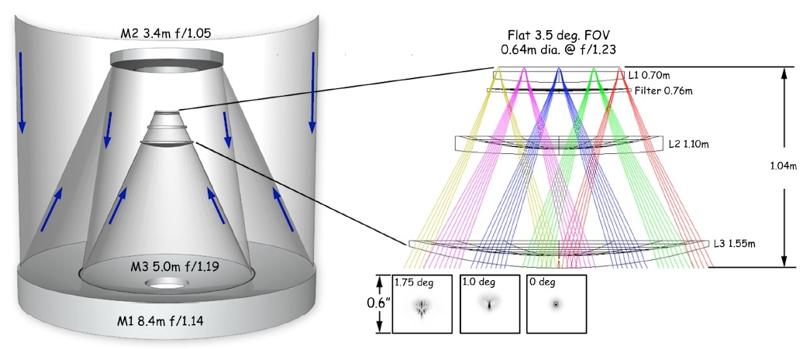
Optical Design for LSST
Three-mirror design (Paul-Baker system) enables large field of view with excellent image quality:
delivered image quality is dominated by atmospheric seeing

Slide 16
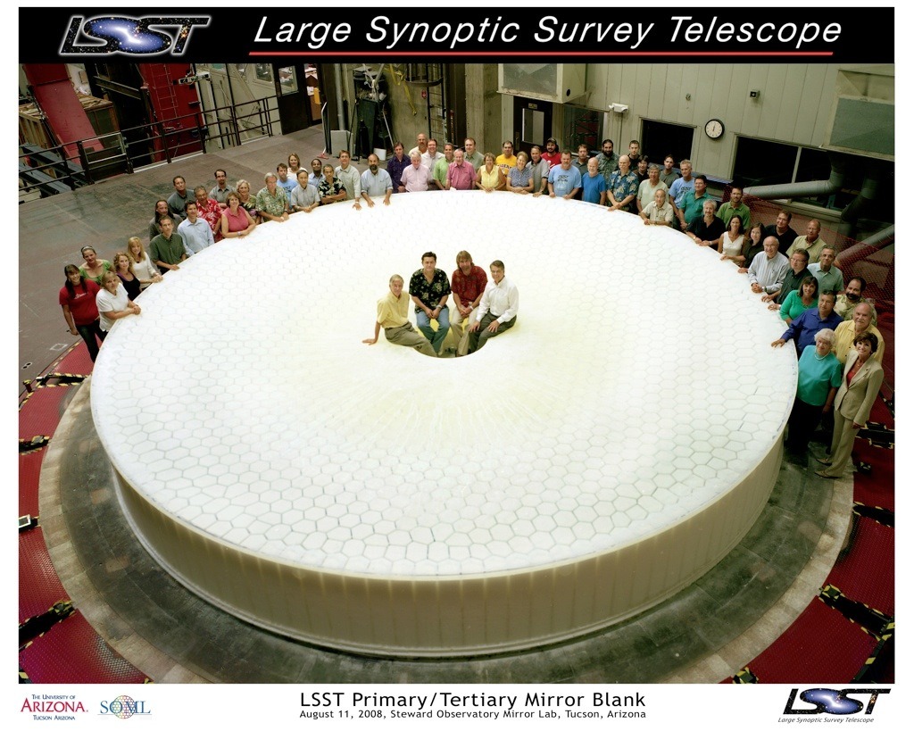

Slide 17
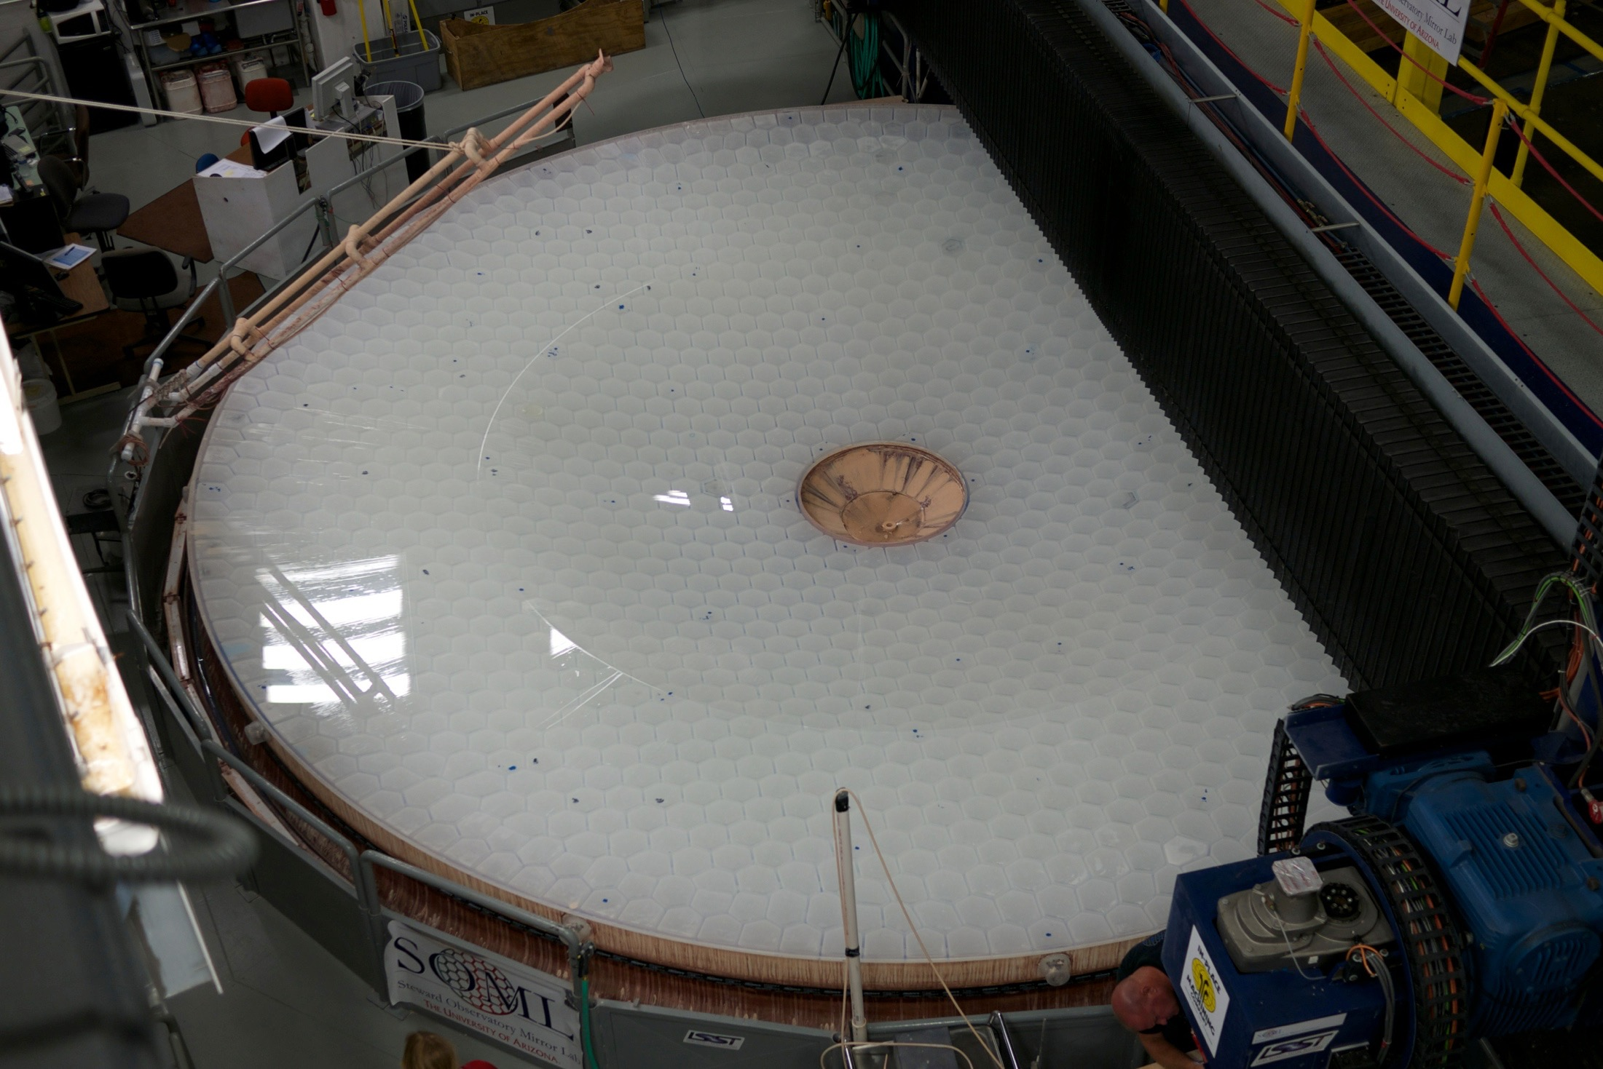

Slide 18
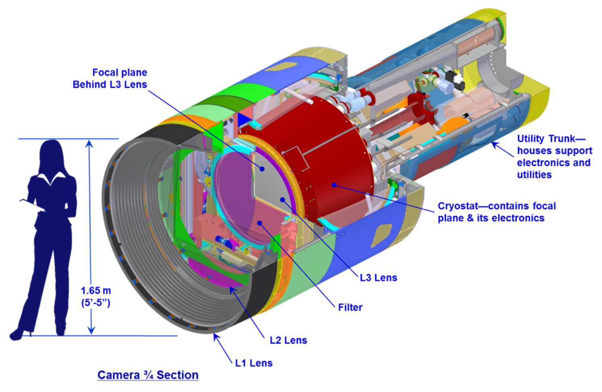
LSST camera
The largest astronomical camera: 2800 kg, 3200 Megapix

Slide 19
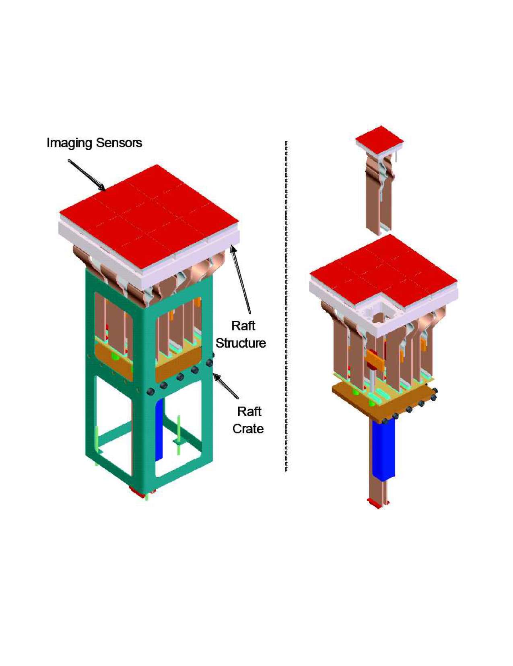
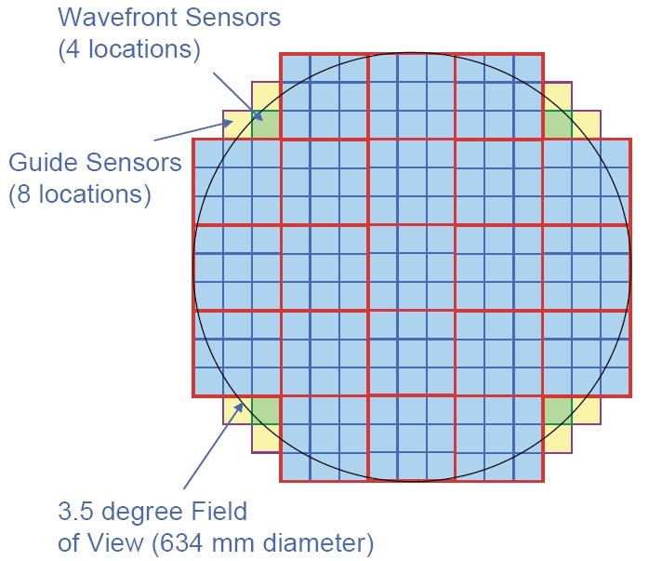
LSST camera
Modular design: 3200 Megapix = 189 x16 Megapix CCD
9 CCDs share electronics: raft (=camera)
Problematic rafts can be replaced relatively easily
LSST Science Sensor procurement (~200 CCDs) is complete!

Slide 20
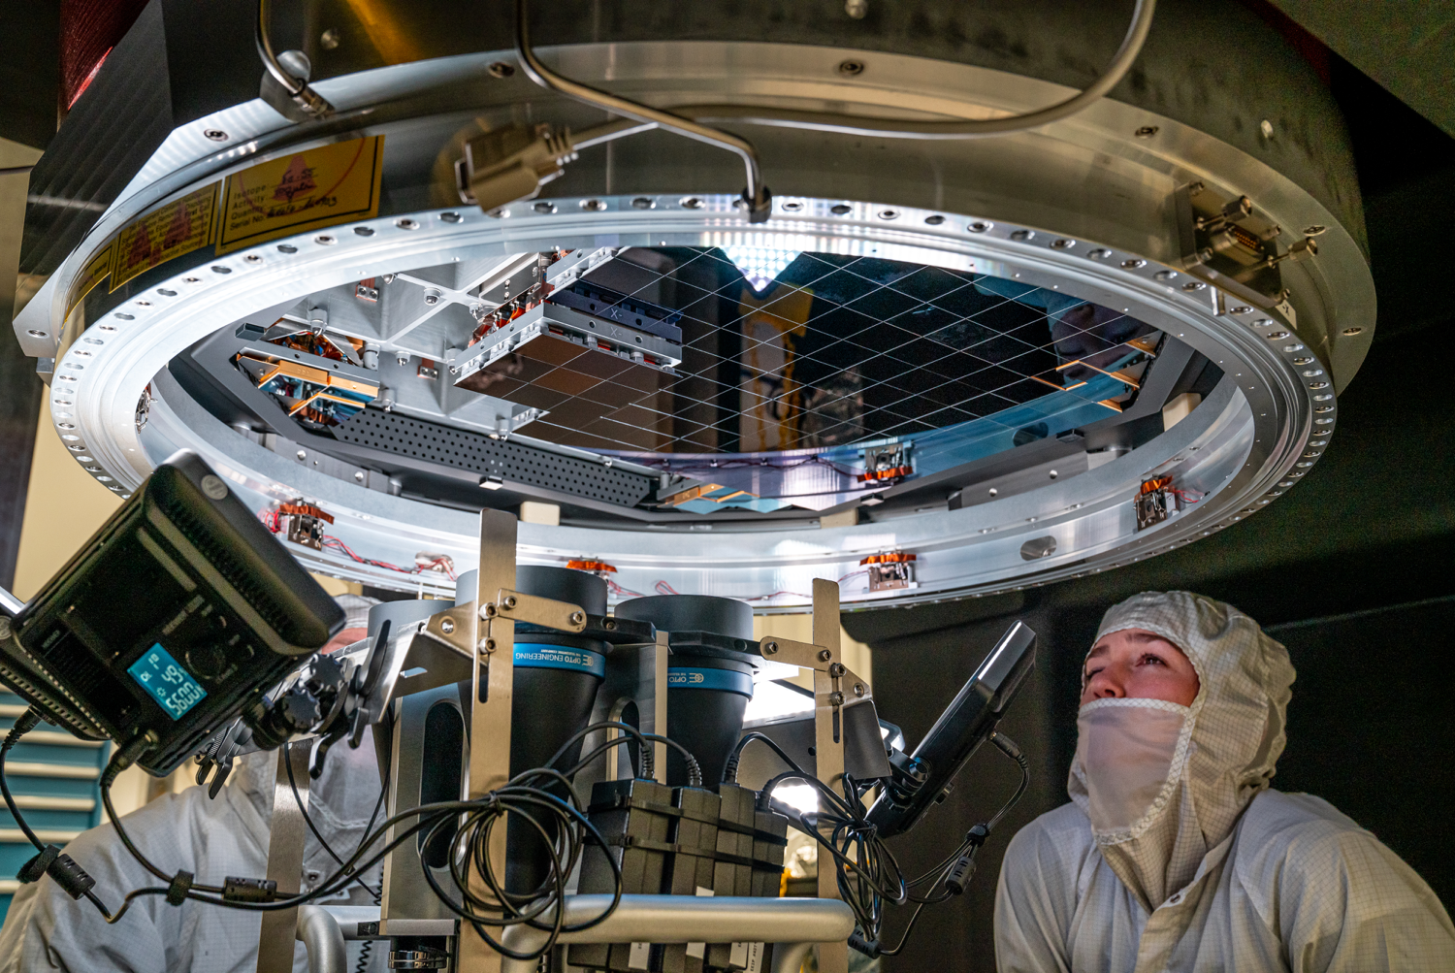

Slide 21
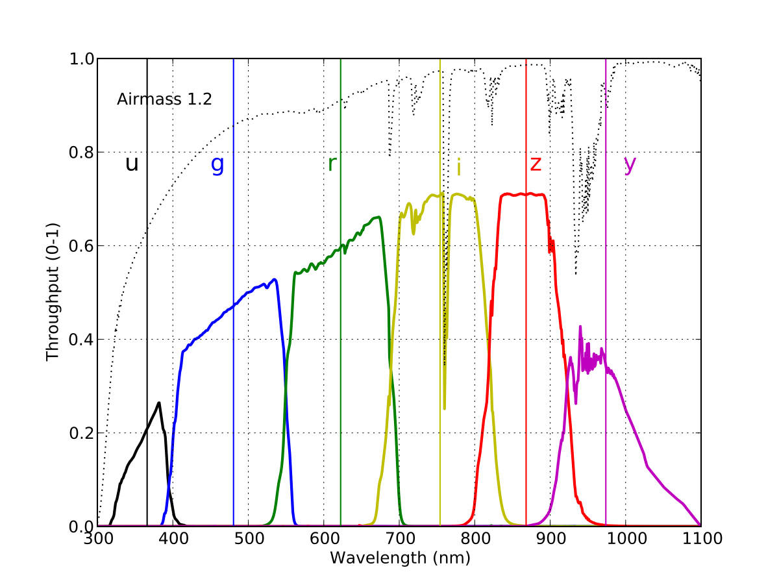
Filter complement
Photometric redshifts for galaxies: random errors smaller than 0.02, bias below 0.003, fewer than 10% >3σ outliers
These photo-z requirements are one of the primary drivers for the photometric depth and accuracy of the main LSST survey (and the definition of filter complement)
Photo-z requirements correspond to r~27.5 with the following per band time allocations:
u: 8%; g: 10%
r: 22%; i: 22%
z: 19%; y: 19%
Consistent with other science themes (stars)

Slide 22
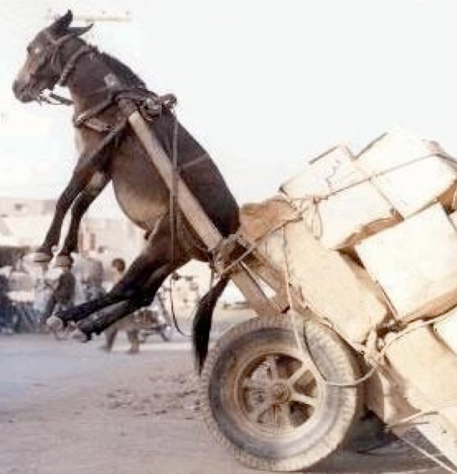
LSST Data Management System (“software”)
20 TB of data to process every day (~one SDSS/day)
1000 measurements for 40 billion objects during 10 years
Existing tools and methods (e.g. SDSS) do not scale up to LSST data volume and rate (100 PB!)
About 5-10 million lines of code (C++/python)

Slide 23
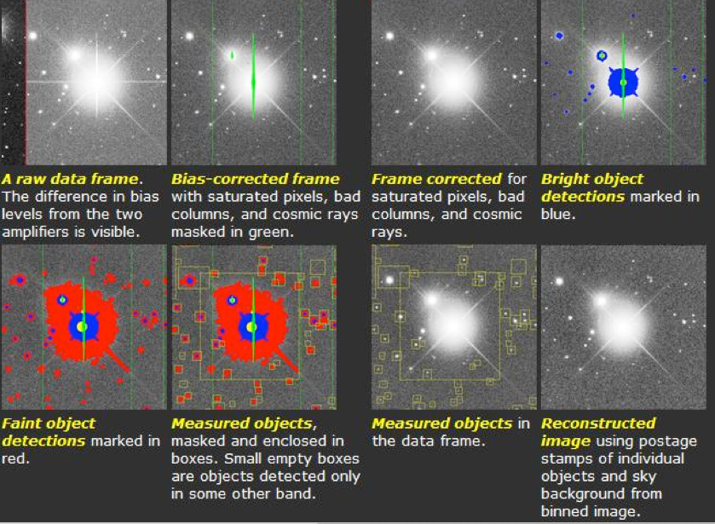
Astronomical catalogs: – a list of all detected objects (stars, galaxies, ...) – measured parameters (size, color, brightness,...)
Basic steps in astronomical image processing (example: Sloan Digital Sky Survey):
All these (complicated) steps are already done:
“science-ready database”

Slide 24
Outline
Rubin Observatory and LSST - multi-color time-resolved faint sky map - 20 billion stars and 20 billion galaxies
Data analysis challenges ahead of us - large data sets - complex analysis - aiming for small systematics

Slide 25
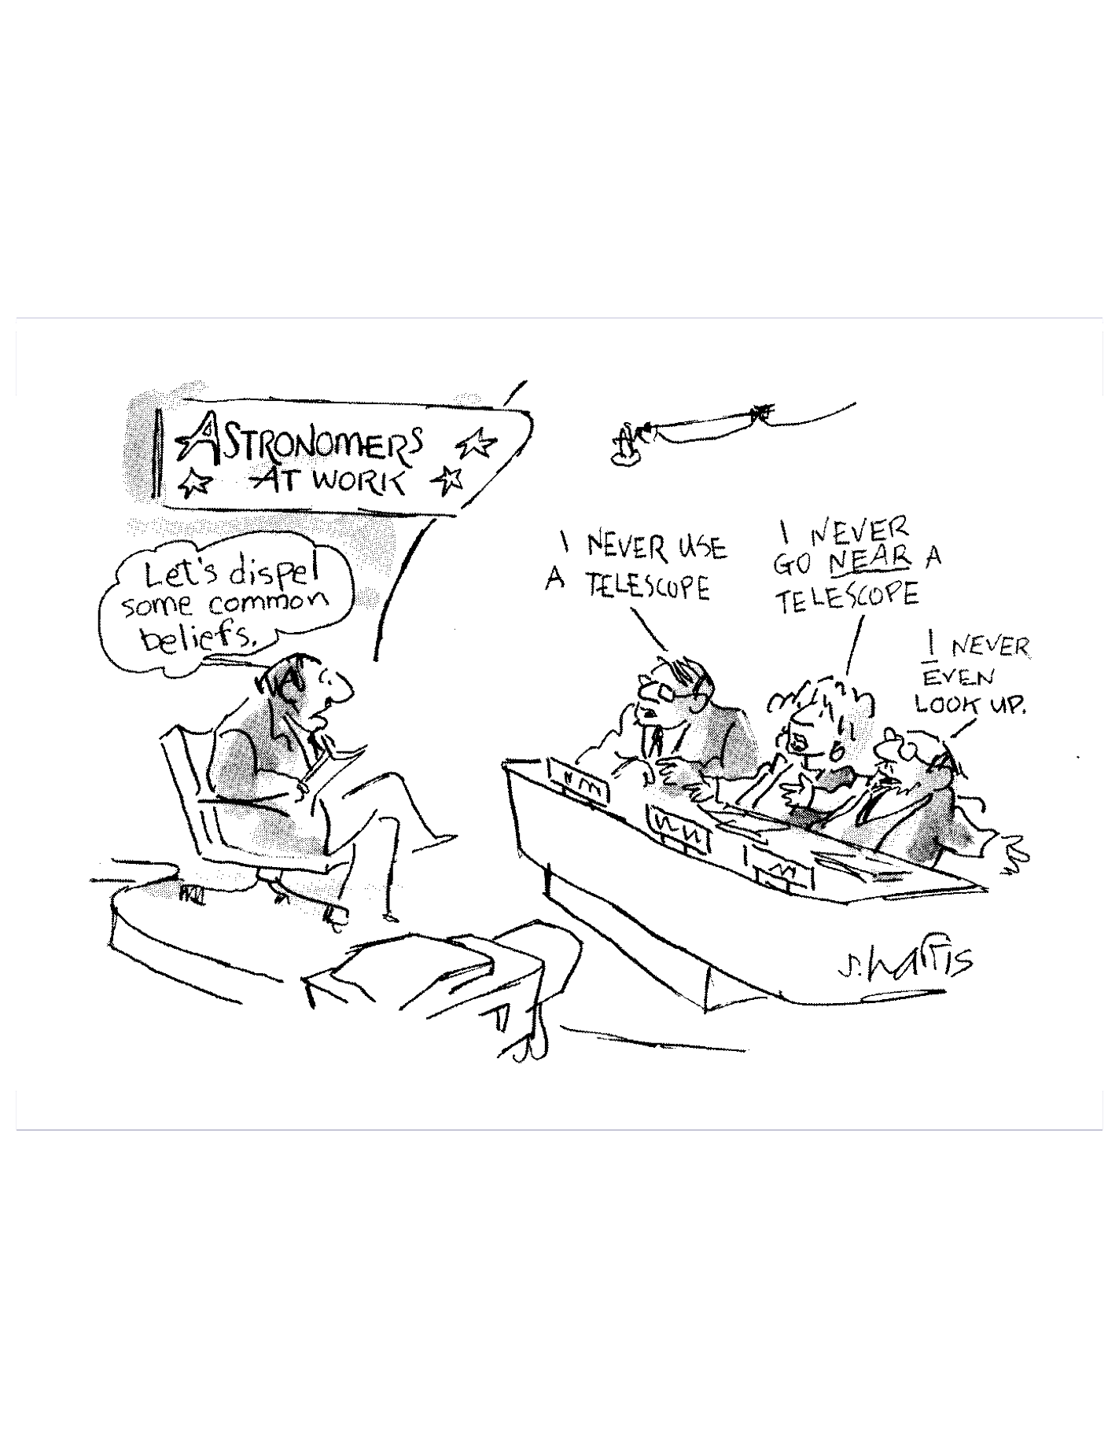
“Ask Not What Data You Need To Do Your Science,
Ask What Science You Can Do With Your Data.”
The era of surveys...
Standard: “What data do I have to collect to (dis)prove a hypothesis”?
Data-driven: “What theories can I test given the data I already have?”

Slide 26

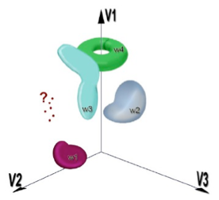
Statistical analysis of a massive LSST dataset
A large (100 PB) database and sophisticated analysis tools: for each of 40 billion objects there will be about 1000 measurements (each with a few dozen measured parameters)
Data mining and knowledge discovery
10,000-D space with 40 billion points
Characterization of known objects
Classification of new populations
Discoveries of unusual objects
Clustering, classification, outliers

Slide 27
Data analysis challenges in the era of Big Data
1) Large data volume (petabytes)
2) Large numbers of objects (billions)
3) Highly multi-dimensional spaces (thousands)
4) Unknown statistical distributions
5) Time-series data (irregular sampling)
6) Heteroscedastic errors, truncated, censored and missing data
7) Unreliable quantities (e.g. unknown systematics and random errors)
The bottleneck will not be data availability but instead our ability to extract useful and reliable information from data.

Slide 28
Everything we’d like to do with LSST data,
but don’t know (yet) how
(Ivezić, Connolly, Jurić: arXiv:1612.04772)
Interpretation of spectral energy distributions (SEDs)
2) Spatial correlations
3) Moving objects
4) Variable objects
5) Systematic measurement uncertainties
6) Astrophysical simulations and astrophysical systematics
7) LSST System Enhancements
8) New algorithms in LSST

Slide 29
Interpretation of spectral energy distributions (SEDs)
- efficient and robust interpretation of time-resolved
multi-band photometry for “billions and billions” of objects
Because of integration over broad bandpasses, forward modeling using a trial SED is superior to “correcting data" (fluxes, positions, sizes):
a) photo-z algorithms: observed SED depends on the redshift of an intrinsic SED (expansion of the universe, source evolution, intergalactic extinction)
b) photometric parallax for stars (will greatly benefit from Gaia parallaxes)
c) photometric metallicity for stars (trained using spectroscopic metallicities)
d) interstellar extinction along the line of sight for stars in the Milky Way disk
e) astrometric effects due to atmosphere (point-spread-function effects, image differencing, finding quasars)

Slide 30
Statistical analysis of a massive LSST dataset
A large (100 PB) database and sophisticated analysis tools: for each of 40 billion objects there will be about 1000 measurements (each with a few dozen measured parameters)
Data mining and knowledge discovery
10,000-D space with 40 billion points
Characterization of known objects
Classification of new populations
Discoveries of unusual objects
Clustering, classification, outliers

Slide 31
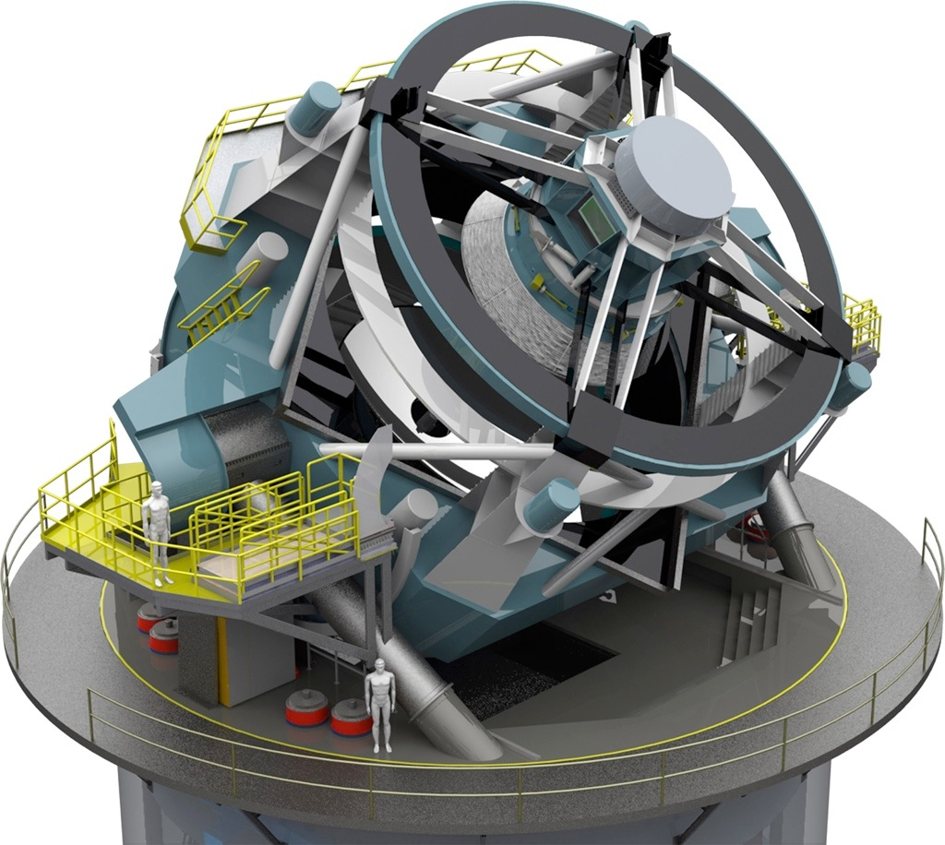
Image 1
Image 2
Difference
Additional “followup” data obtained to:
- confirmation and classification
- provide better temporal resolution
- use different filters/wavelengths
- obtain spectra (distance!)
- other measurements (e.g. polarimetry)
Alert!
Image 1
Image 2
Difference
~10 billion alerts
Alerts can trigger “Followup” observations:

Slide 32
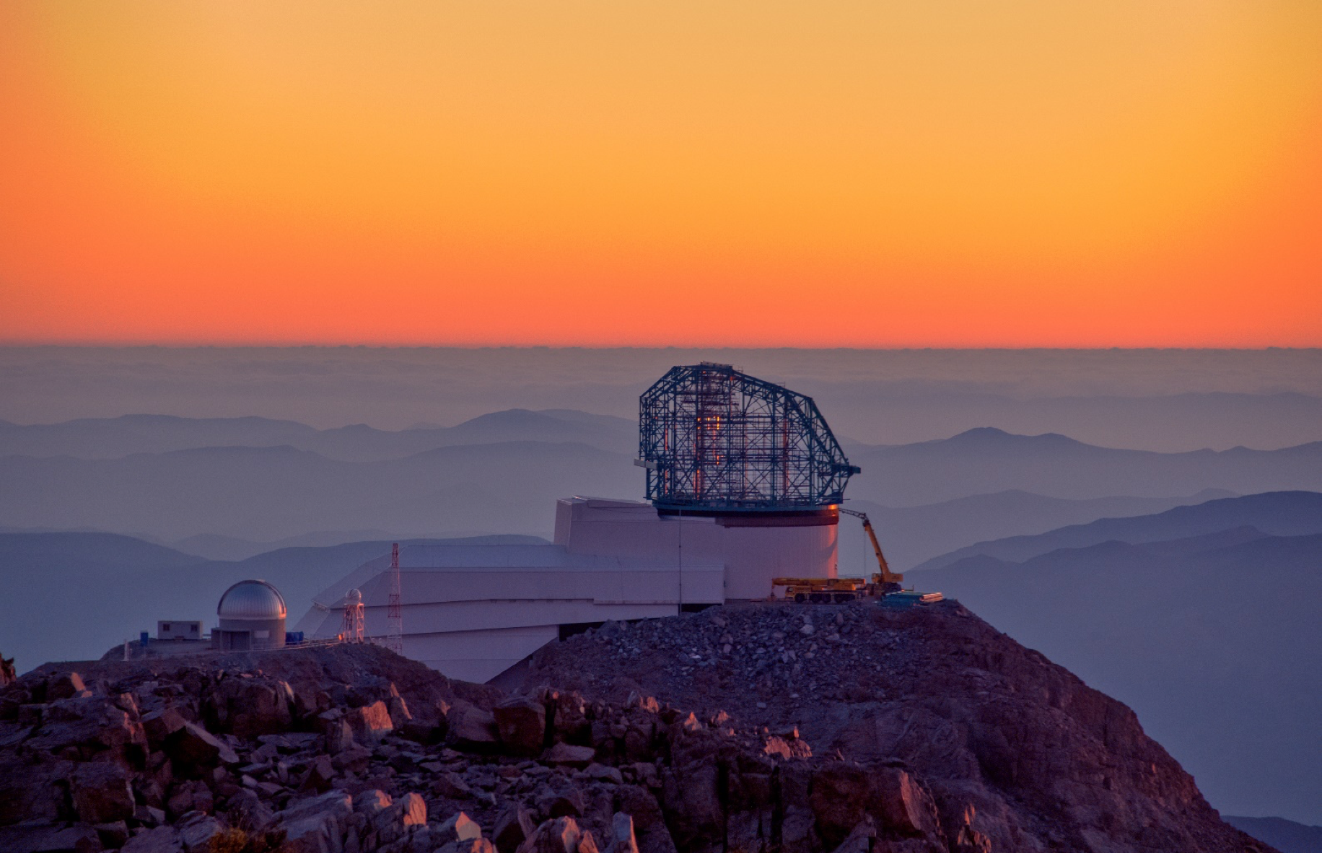
LSST: a 10-year survey starting in Oct 2022
multi-color time-resolved faint sky map - 20 billion galaxies (median redshift ~1) - 20 billion stars (to the edge of the Milky Way) - 10 billion alerts (across the Universe) - “millions and millions” of SNe, quasars, asteroids…
data analysis challenges: waiting for you!
Summary
More details:
LSST overview paper: arXiv:0805.2366
LSST Data Products Definition Document: ls.st/dpdd
LSST Science Requirements Document: ls.st/srd

